Slide 1
Autonomous Systems for Aerospace
Calogero Carlino Luca Francesco Macera

Slide 2
What is Aerospace?
Aeronautics
Spaceflight
Aerospace
Aeronautics
Astronautics
Aviation
within Earth’s atmosphere
outside Earth’s atmosphere
the operational aspects of the aircraft
Notes:
Therefore, aerospace deals with the design, manufacturing, and maintenance of aircrafts or spacecrafts and can be thought of as the science of flight within Earth's atmosphere as well as outside it.
Aeronautics: it is basically all things aeroplane-related within Earth's atmosphere.
Astronautics: it is basically all things aeroplane-related outside Earth's atmosphere.
Aviation: the operational aspects of the aircraft

Slide 3
Intelligent Autonomy for Aerospace Engineering Systems
Communication, Navigation, and Surveillance (CNS)
Guidance, Navigation, and Control (GNC)
systems of aircraft
systems for air vehicles
Notes:
The evolution of the aerospace engineering systems involves upgrades and updates on
—-------------------------------------------------------
For both, the aeronautical community is looking for more intelligent aerospace systems where autonomy plays a key role to keep air transportation safe and secure.

Slide 4
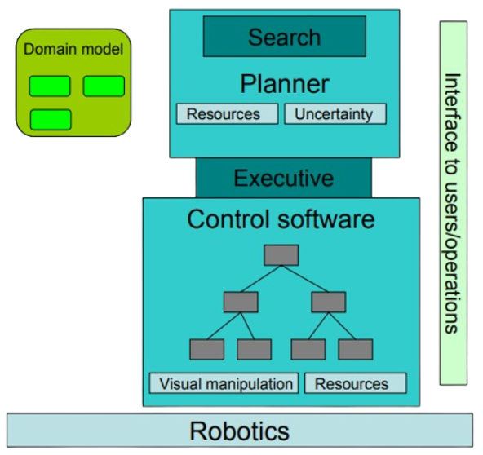

constraints that describe the relationships between elements of the system and the flight rules that need to be followed during planning
Decision layer
consists of a domain model and a search engine
does the actual planning
Middle layer
takes a plan and "executes" it by issuing commands to the controllers in the bottom layer
Functional layer
a collection of controllers that actually command the hardware devices of the physical system
Notes:
The top layer, also called the decision layer, consists of a domain model and a search engine.
The domain model lists the constraints that describe the relationships between elements of the system and the flight rules that need to be followed during planning.
The search engine does the actual planning, i.e., it elaborates and scheduled activities to meet a given goal under the constraints described in the domain model.
The output of the decision layer is a plan
The middle layer, also called the executive, takes a plan and "executes" it by issuing commands to the controllers in the bottom layer, also called functional layer. The executive is responsible for issuing commands, checking that commands are actually executed, and responding to exception signals generated by the controllers.
The functional layer is a collection of controllers that actually command the hardware devices of the physical system. This is the lowest level of an autonomy software system.
The architecture also needs to support reconfiguration, not only in terms of adding, removing, or changing components in the functional layer, but also in terms of adding planning and execution capabilities.

Slide 5
Verification
Verification is one of the most challenging issue for IA (Intelligent Autonomy) and that’s because truly intelligent and autonomous system can have too many combinations of different output(s) for the same input(s). This makes very difficult the generation of all the possible combinations for the above inputs and outputs.
In order to have a robust architecture, every component in the autonomous system built with the architecture must be verified.
Functional layer | V&V approach based on embedded system verification applied in a straightforward manner
Executive and Planner | “heavy” V&V techniques to verify that the mechanical operation of the reasoning engine are properly performed.
Domain model | the concern is well-formedness, consistency and completeness
Notes:
Additionally, it can have the different outputs for the same set of inputs which makes IA behavior tough to predict.
From a Verification and validation (V&V) point of view, each element requires different techniques, even though some basic techniques (such as code analysis) can be applied across the board
The functional layer, containing the control software, is the closest to traditional embedded software systems. It mostly consists of control device drivers for actuators or sensors as well as mathematical and algorithmic libraries. For these elements, we are mostly concerned with certifying that they cannot crash. This suggests that a V&V approach based on embedded system verification can be applied in a straightforward manner.
In some high-level view, the executive and the planner are quite similar. Using a formal model (the domain model for the planner and a plan for the executive), a reasoning engine computes an output (a plan for the planner and low-level commands for the executive). The reasoning engine is usually fairly mechanical (mostly performing searches) and rarely changed (in theory, only the domain model changes for a new application). Therefore, we can afford to bring to bear some “heavy” V&V techniques (e.g., precise static analysis, theorem proving) to verify that the mechanical operation of the reasoning engine (e.g., graph expansion, constraint propagations, and rollbacks) are properly performed.
For the domain model, the concern is well-formedness (are constraints legal?), consistency (can constraints lead to inconsistent solutions or a deadlock?), and completeness (have we specified all necessary constraints?).

Slide 6
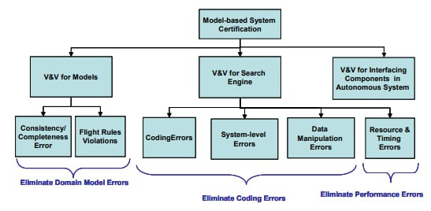
Verification
Mechanical properties are organized in a hierarchy that reflects the masking power of each fault class. This imposes a natural progression in the verification process.
Notes:
As mentioned above, the engine requires checking for “mechanical” properties while models require some functional correctness verification. As shown in the picture, mechanical properties include programming errors, system-level errors, and data manipulation errors. These properties are organized in a hierarchy that reflects the masking power of each fault class. For example, programming errors might mask synchronization errors, which in turn might mask data manipulation errors. This imposes a natural progression in the verification process: first, eliminate programming errors, then system-level errors, and finally, data manipulation errors.

Slide 7
System Assurance
1
2
Preventing prohibited actions from happening
Making sure that required actions happen
Notes:
An autonomous system can, prospectively, be compromised by attacks against the AI (which seek to control it, overwhelm it or otherwise) as well as attacks against the supporting systems which the AI relies upon.
Cybersecurity is part of a larger area of consideration:
—--------------------------------------
Assurance can be subdivided into two categories which can be effectively summed up as
—--------------------------------------
Required actions that must be assured to happen include generating power of the amount required and onboard computing, which is required for controlling the spacecraft.
Prohibited actions that must be prevented begin with the important goal of preventing overheating.

Slide 8
Cybersecurity
The cybersecurity needs of a system are a subset of the assurance needs of the system. Cybersecurity is primarily concerned with three areas.
Onboard software operations
Ground station software operations
Transmission link security
Notes:
In the first two categories, malware or other attack could prospectively cause the system to be activated at incorrect times.
Transmission link security could cause similar issues. It may result in incorrect position, time or orientation knowledge.
Also problematic is the fact that an exploit in any of these areas may place the spacecraft into an inconsistent state where further command is not possible but anyone.

Slide 9
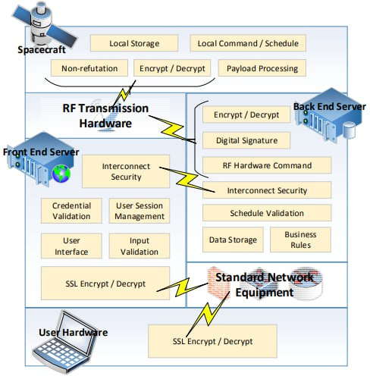
Cybersecurity
This kind of system is comprised of multiple parts, referred to as segments, in the parlance of space mission design
the ground segments must be secured against unauthorized access, tampering and the loss of informations.
the communications pathways to and from the ground must be secured to prevent DoS, misuse or the loss of critical information.
third-party systems on which the spacecraft relies on for information must be secured against providing incorrect information or being impersonated by a malicious party.
the spacecraft itself must be secured against actioning unauthorized commands and providing sensitive data to unauthorized parties.
Notes:
Standard techniques exist for virtually all of these areas. These include standards for data encryption/decryption, access control and credential management, intrusion detection and such.

Slide 10
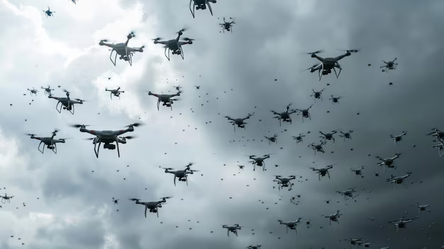
An Autonomous Distributed System of UAVs
It’s a network of different unmanned aerial vehicles (UAVs) for fly/over operations over complex environment (forests, dense urban locations) to gather data.
Inspired from the behaviour of certain species of migratory birds, it’s possible to achieve a more coherent and organized flying pattern.
This increases the maximum field of view of and a better coordination when operating (better collision avoidance, coverage)

Slide 11
System Policies
1
2
Short term objectives like obstacle avoidance and coordination
Long term objectives like path planning and shortest route calculation

Slide 12
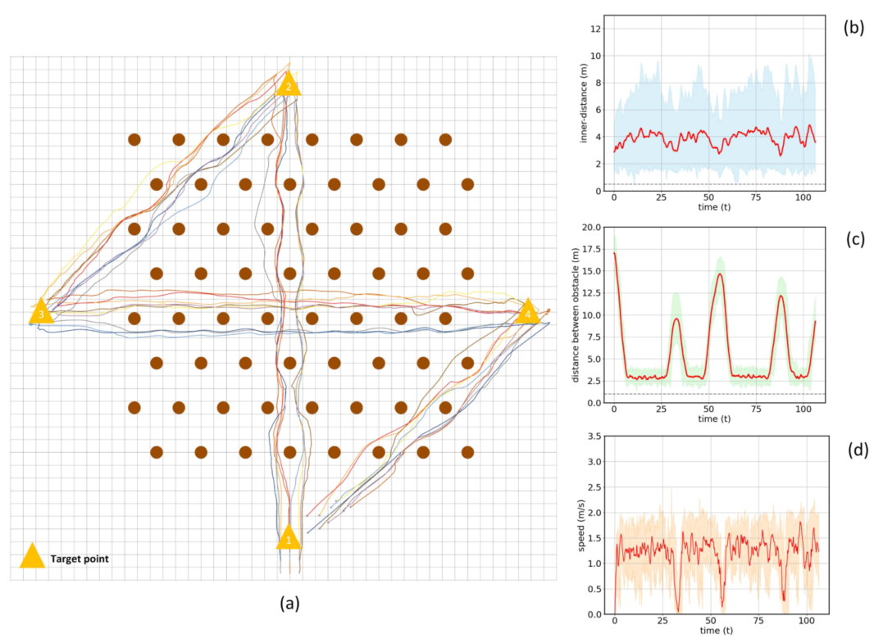
Forest Traversal
The swarm must fly through a dense forest, modeled using cylindrical obstacles, and should arrive at 3 destination without breaking formation.
Some results:
Average velocity of 1.5m/s
No device broke formation
Maintained a safe minimum distance between the obstacles and other agents

Slide 13
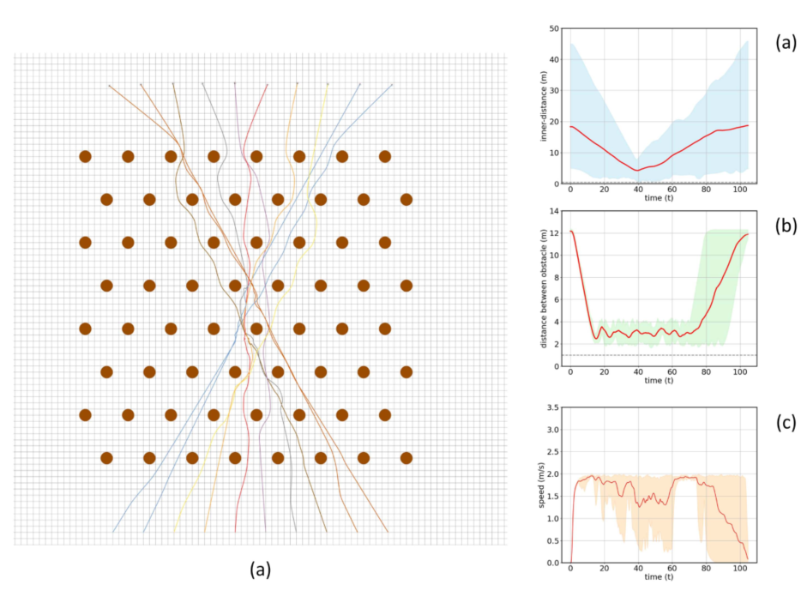
Reciprocal Collision Avoidance
Each drone is assigned a specific trajectory, and must avoid collision with other devices and obstacles that may be in the way.
The main result was that the drones were able to react quickly and maintain a minimum safe distance not only with the environment, but with other devices.

Slide 14
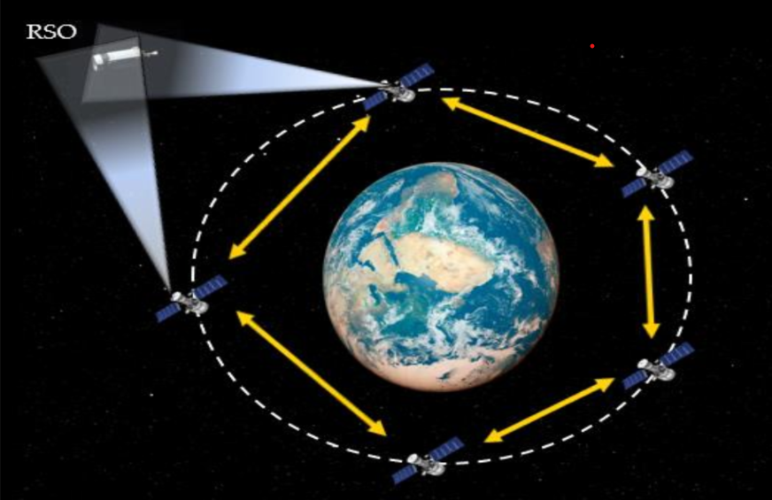
A Distributed System of Satellites for Space Surveillance
With the increase of space junk and the concern of foreign objects (RSO), a system was devised to monitor their movement.
Using a distributed system of autonomous satellites, it’s possible to keep track of the position of these objects and make sure that they pose no threat to the orbiting devices present.

Slide 15
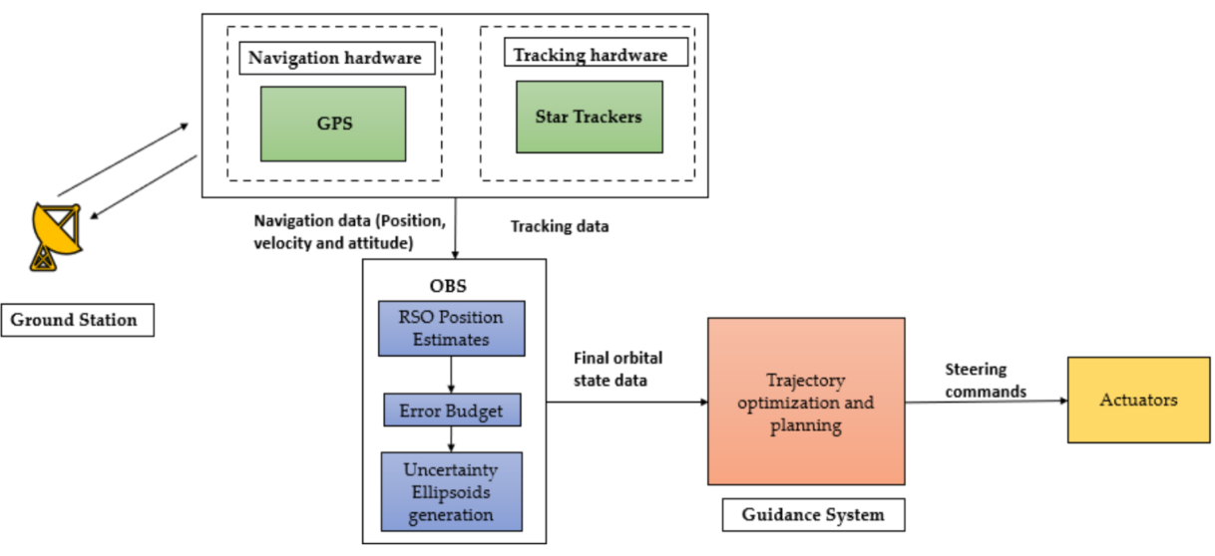
A System Architecture Overview
Notes:
The satellite is made up of two hardware modules: The navigational is responsible of tracking the location and motion of the machine; The tracking hardware uses optical sensors to locate and monitor the RSOs that enters the satellite’s view. The On-Board System (OBS) is used to estimate the position of the RSO and its trajectory. Finally the guidance system is used to move the satellite in case of a collision.

Slide 16
System Results
The network was able to detect and calculate a good approximation of the trajectory of a dummy object placed in the environment, with negligible errors in the exact predictions of the future coordinates of it.
Using this calculations, the agents present in the network, were able to reposition themselves to avoid the predicted path without going too much out of orbit.

Slide 17
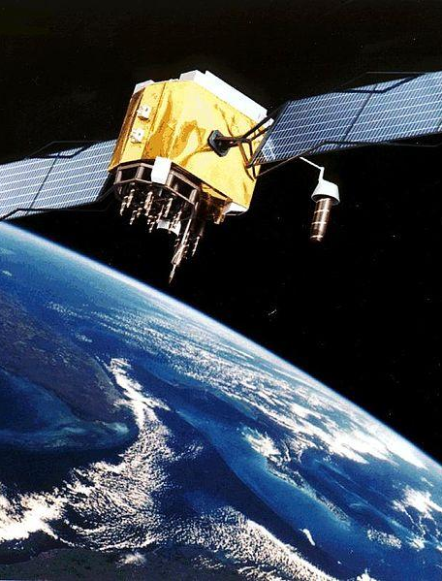
Conclusions and Future Prospects
Even tho a lot of application nowadays rely on system that are capable of working without the assistance of human labor, we are still a long way to achieve a truly autonomous system, especially for long space exploration and research.
The main open points:
Better means of communications.
Self preservation and protection strategies (self repair functionalities and better materials)
Resource optimization (self reconfiguration, energy consumption, memory management)

Slide 18
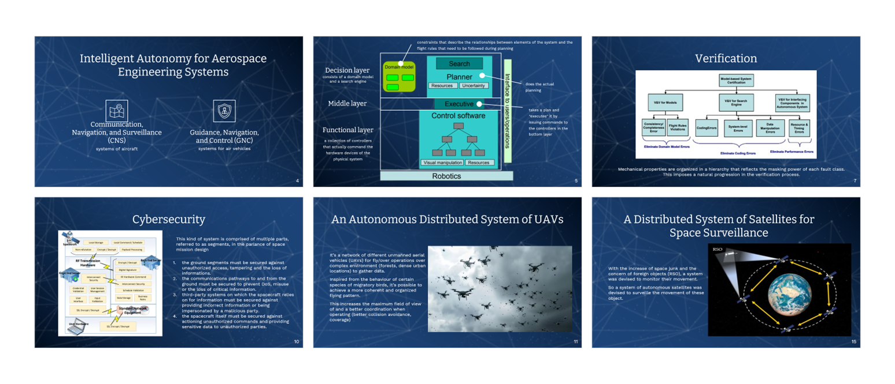
Final Summary

Slide 19
Thanks!

Slide 20
References
[1] Intelligent Autonomy for Aerospace Engineering Systems, https://ieeexplore.ieee.org/document/8569358
[2] Verification of Autonomous Systems for Space Applications, https://ieeexplore.ieee.org/abstract/document/1656029
[3] Intelligent Systems For Aerospace Engineering--An Overview, https://ntrs.nasa.gov/citations/20020065377
[4] A Briefing on Metrics and Risks for Autonomous Decision-making in Aerospace Applications, https://arc.aiaa.org/doi/abs/10.2514/6.2012-2402#
[5] Cybersecurity for aerospace autonomous systems
https://www.spiedigitallibrary.org/conference-proceedings-of-spie/9468/94680M/Cybersecurity-for-aerospace-autonomous-systems/10.1117/12.2177959.short
[6] Autonomous and autonomic systems: a paradigm for future space exploration missions, https://ieeexplore.ieee.org/abstract/document/1629194
[7] A Distributed Autonomous System for Multi-UAVs With Limited Visualization: Employing Dual-Horizon NMPC Controller
https://ieeexplore.ieee.org/abstract/document/10553330
[8] Autonomous Optical Sensing for Space-Based Space Surveillance, https://ieeexplore.ieee.org/document/10115786

